Slide 1
INSTRUCTIONS
Use Font size 22 to 28 and Font Style Times New Roman (body)
Do not change the Template: Heading / Title of the slides
Do not change font style or colours
Do not copy paste paragraphs: use only Bullet Points
Maximum slide Limit is 20 only
As per the number of supervisor allotted adopt slide-2 or slide-3
Please display the required meaningful Content or images or tables
Change the footer accordingly using insert tab then click on header & footer tab and edit it
Save the PPT with Register No, Dept and Review no, example: 23xxxxxxxxx_CSE

Slide 2

Title :CAREER COMPASS FOR STUDENT DREAMS
Student Name: M.Mohana Asmitha
Student ID: 2520030486
Cluster: 3
Section: 11
Under the Guidance
of
Supervisor Name: Mrs.Surekha
Assistant Professor
Department of CSE

Slide 3
OUTLINE
Abstract
Existing System
Proposed System
System Architecture
Project Modules
Objectives
Co’s Attainments - FWD
Co1
Co2 …….. 5. Co5
Co’s Attainments - DSA
Co1
Co2 …….. 5. Co5
Screen Shots for FWD & DSA
Conclusion
Geo-Tagged Photos

Slide 4
Abstract
.
Career Compass ForStudent Dreams is a web-based platform that helps students choose suitable careers based on their interests and strengths. Includes a self-assessment quiz to analyze personality, abilities, and career preferences.
Recommends suitable career paths based on student responses and academic background and Displays career details such as description, demand, growth,stability, and salary scope.
Offers information about academic streams like MPC, BiPC, Commerce also Helps students understand important skills required for different career paths.
The RESUME Builder to help students create Professional resumes Easily and Provides English improvement modules vocabulary and sectence practice.
Supports Confidence Devlopment By helping students Overcome Fears also Motivates Students through guidance and career development Support
Overall, The platform motivates students and helps them make informed career decisions for the future..
.
.
.

Slide 5
Existing System
Platforms provide online courses and resources to help students learn career skills.
Some systems offer aptitude tests to analyze student interests and abilities.
Career guidance websites suggest suitable professions based on quiz results.
Many platforms provide career information such as salary, demand, and skills.
Some tools recommend learning paths and certifications for specific careers.
Certain platforms help students build resumes and improve professional profiles.
Few systems provide basic guidance to explore different career opportunities.
Some modern career platforms use AI-based systems to provide personalized career recommendations and learning paths.
A few systems provide mentorship programs where professionals guide students about career growth and industry expectations.

Slide 6
Proposed System
Web-based career guidance system for students.
Secure login and registration system that provides personalized access for each student.
Career exploration module providing detailed information about different professions.
Self-assessment quiz to analyze student interests, strengths, and career preferences.
Career recommendation system that suggests suitable professions based on quiz results
Resume Builder Feature The system includes a resume builder that helps students create a professional resume
English improvement module to help students develop communication skills.
Motivation and guidance system that encourages students to stay focused on career goals.
User-Friendly and Interactive Interface navigate through different features

Slide 7
System Architecture
User Interface (UI)
designed using HTML pages including login, registration, dashboard, courses, quiz, skills, resume builder, English, and confidence modules.
CSS styling →create buttons, forms, and dashboard design.
JavaScript handles frontend logic such as login, registration, logout, navigation,
Resume Builder Module → Generates professional resumes with live preview.
English Learning Module → Vocabulary practice and communication improvement.
Confidence Support Module → Helps reduce stage fear, exam stress, and speaking anxiety.
Data Storage Layer → Uses JavaScript arrays and browser localStorage for user and career data.

Slide 8
Project Modules
Module 1: Authentication — Login and registration using HTML forms and JavaScript validation; user details stored in localStorage with secure dashboard access and logout functionality.
Module 2: Career Data Management — Career dataset stored in JavaScript objects containing career name, description, demand, growth, salary scope, roadmap steps, and required skills information.
Module 3: Dashboard Overview — Student dashboard displays welcome message, motivation quotes, career readiness insights, and quick navigation links to explore careers, quiz, skills, and resume builder.
Module 4: Career Exploration — Students browse multiple professions with detailed descriptions, demand graphs, stability insights, salary scope, and structured step-by-step career roadmaps.
Module 5: Self-Assessment Quiz — Psychometric quiz collects interests, academic stream, strengths, and preferences, helping analyze personality and suggest suitable career directions.
Module 6: Career Recommendation System — JavaScript logic processes quiz responses and generates recommended careers based on interests, subjects, and student personality traits.
Module 7: Skills and Resume Module — Displays required career skills and allows students to create professional resumes including education, projects, certifications, and skills with live preview.
Module 8: English and Confidence Module — Provides vocabulary learning, sentence practice, communication tips, and confidence guidance to reduce stage fear, exam stress, and English speaking anxiety.

Slide 9
Objectives
To develop a career guidance website that helps students explore different career options based on their interests and skills.
To provide career information including required education, skills, and opportunities for various professions.
To help users identify suitable career paths through a self-assessment quiz.
To allow users to create a basic resume using the resume builder feature.
To help students track and improve their skills using a skills tracker system.
To design a simple and user-friendly interface that makes career exploration easy for students.
To store and manage user data efficiently such as profile information, quiz results, and career preferences.
To enhance student confidence by providing guidance to overcome stage fear, exam stress, and English speaking anxiety.
To design a dynamic dashboard that displays motivation, career readiness insights, and student progress using JavaScript DOM manipulation.
• To demonstrate the practical integration of career guidance, self-assessment, resume building, and confidence development in one web application.

Slide 10
Co’s Attainments - FWD
CO1: Apply Internet fundamentals, HTML, and introductory CSS to design the website structure including login/register pages, dashboard layout, and career information sections.
CO2: Use HTML forms, semantic tags, and CSS layouts to create responsive pages for career exploration, self-assessment quiz, skills module, and resume builder.
CO3: Apply JavaScript programming fundamentals to implement features such as user authentication, career dataset management, and quiz-based career recommendation logic.
CO4: Use JavaScript interactivity and DOM manipulation to enable dynamic functions like career search, quiz analysis, dashboard updates, and resume preview generation.
CO5: Apply advanced web development concepts including form validation, localStorage for data persistence, and deployment of the career guidance website for student use.

Slide 11
Co’s Attainments - DSA
CO1: Searching and Sorting Implemented career search in the Dream Careers section using JavaScript to find careers by name and display demand, growth, stability, and salary comparisons.
CO2: Lists (ADT) Used arrays and objects like courses[], careers{}, and vocabulary lists in app.js to store, traverse, and display career and course data dynamically.
CO3: Stacks and Queues Handled quiz responses sequentially in the Self-Assessment module and processed resume builder inputs step-by-step before generating the live resume preview.
CO4: Hashing Used JavaScript objects and localStorage as key-value storage to quickly retrieve career details, user login information, and resume data within the system.

Slide 12
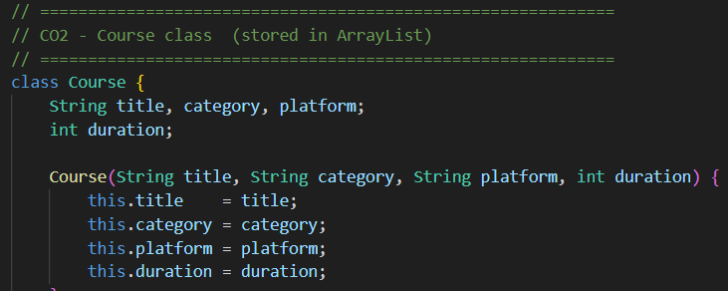
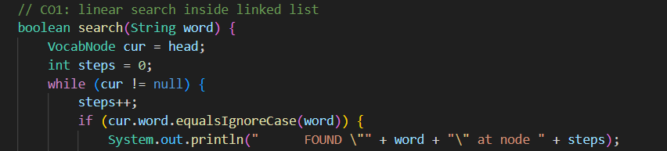
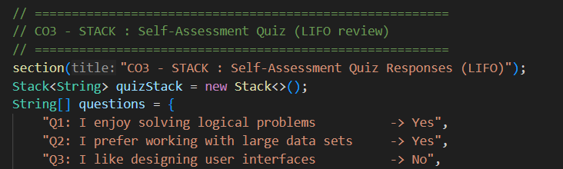
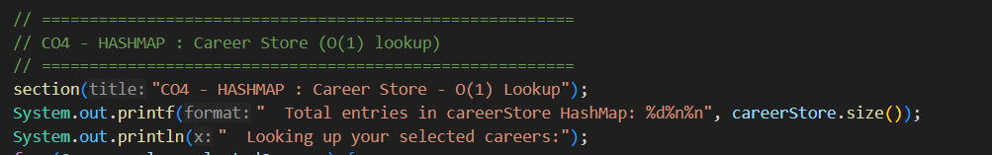
Screenshots for FWD & DSA

Slide 13
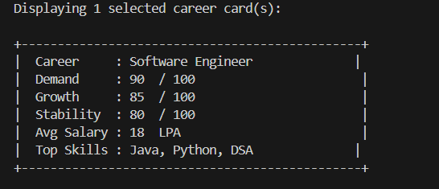
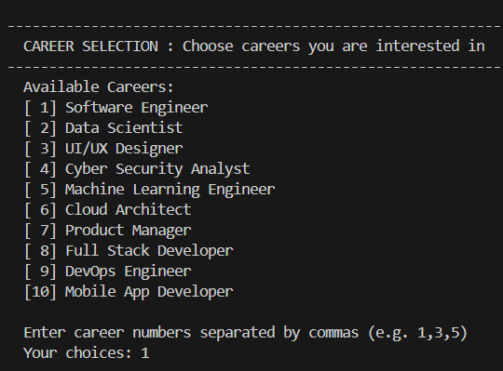
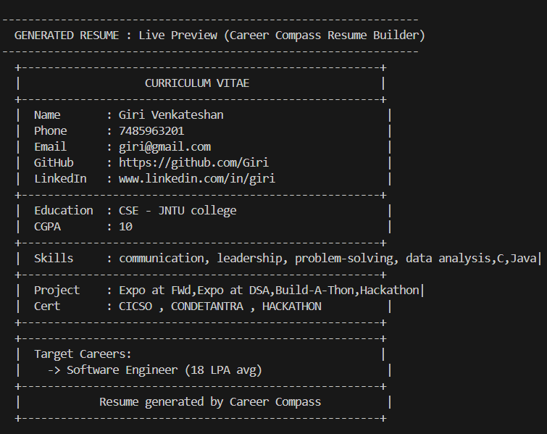
Screenshots for FWD & DSA

Slide 14
Conclusion
The Career Compass for Student Dreams website is a web-based platform designed to guide students in selecting suitable career paths based on their interests, strengths, and academic background. It provides a career exploration module that displays career descriptions, demand, growth, stability, and salary insights. The self-assessment quiz analyzes student responses and recommends appropriate careers. A career roadmap feature guides students step-by-step toward their chosen professions. The system is developed using HTML, CSS, and JavaScript, creating a responsive and interactive interface. Overall, the platform helps students make informed career decisions and demonstrates how modern web technologies can support career planning and student development..
Career exploration module displays different careers with descriptions, demand, growth, stability, and salary insights.
Self-assessment quiz analyzes student interests, strengths, and academic background to recommend suitable careers.
Career recommendation system suggests appropriate professions based on quiz responses.
Career roadmap feature provides step-by-step guidance for achieving selected career goals.

Slide 15
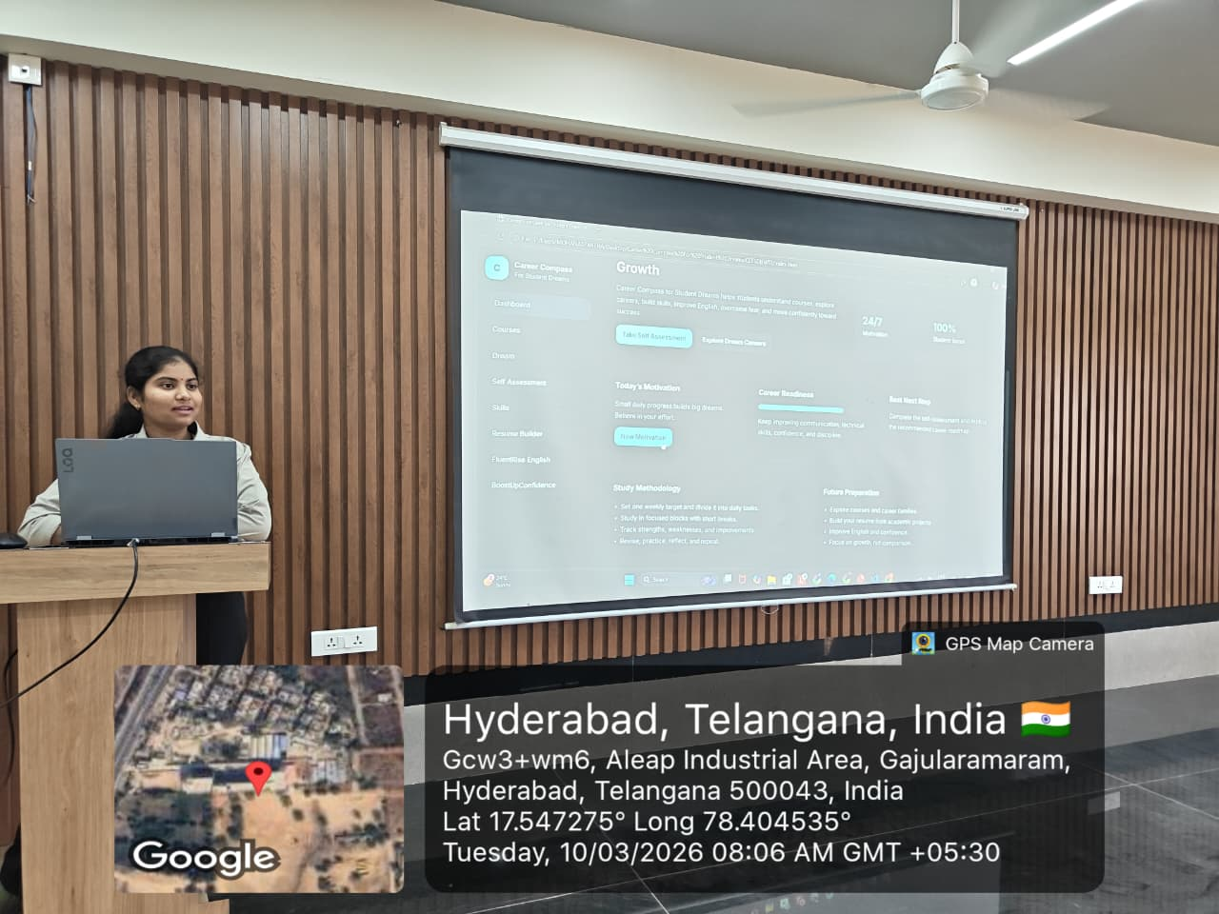
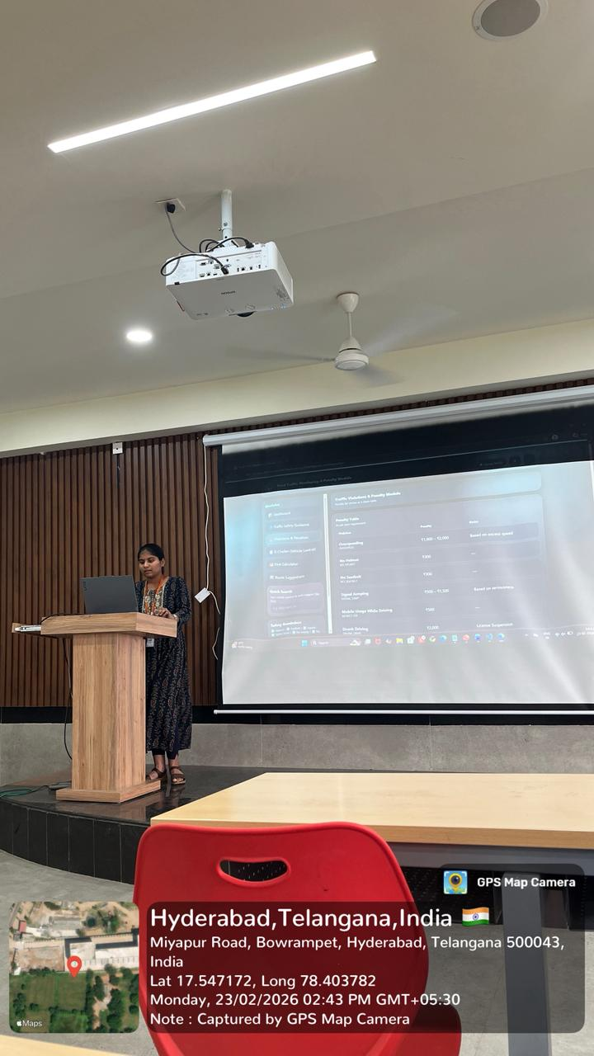
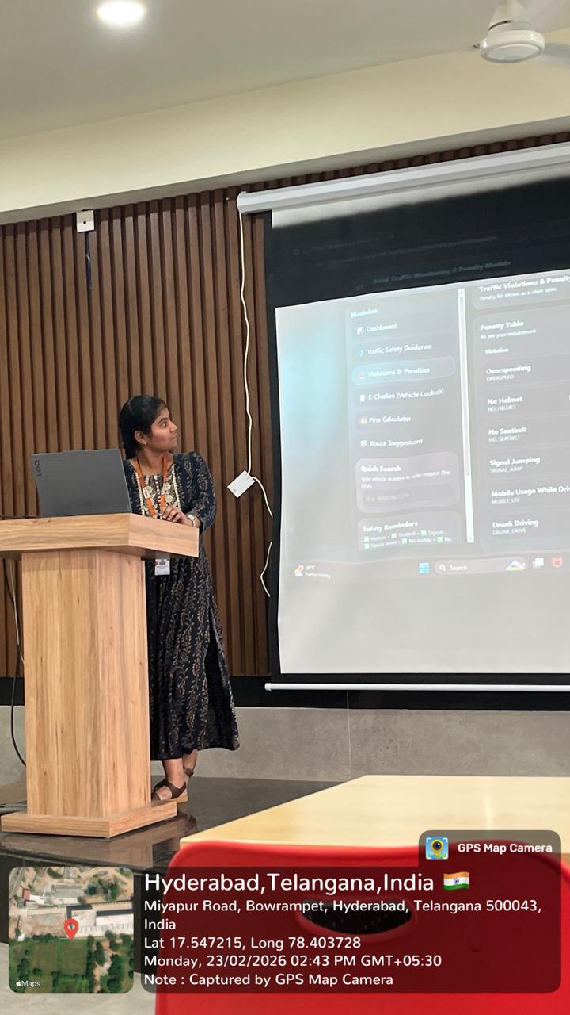
Geo- Tag Photos

Slide 16
THANK YOU

